Slide 1
Machine Learning for Modal Analysis
Vaibhav Malhotra

Slide 2
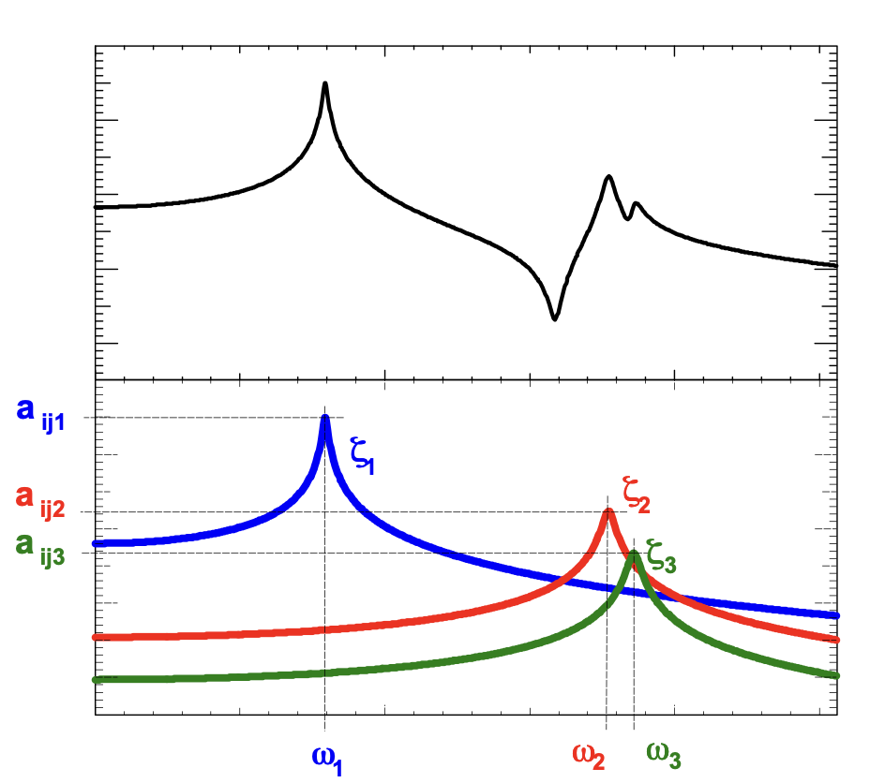
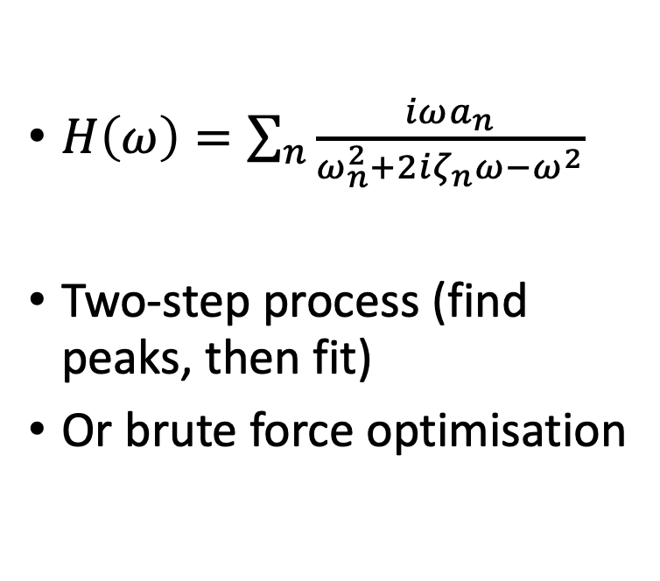
What is Modal Analysis?
$H\left(ω\right)=\sum_{n}{\frac{iωa_{n}}{ω_{n}^{2}+2iζ_{n}ω−ω^{2}}}$
Two-step process (find peaks, then fit)
Or brute force optimisation
Image Reference: Avitabile, P., 2001. Experimental modal analysis. Sound and vibration, 35(1), pp.20-31.
Notes:
Process by which we find the inherent dynamic characteristics of a MDOF system
Do this by splitting into sum of independent SDOF systems (modes), each characterised by natural frequency, damping ratio, modal amplitude
Typically done in frequency domain by way of a transfer function: excite structure w known forcing and measure response over range of frequencies
Two step process (find peaks, then fit (various methods))
Or brute force
Feels done but…

Slide 3
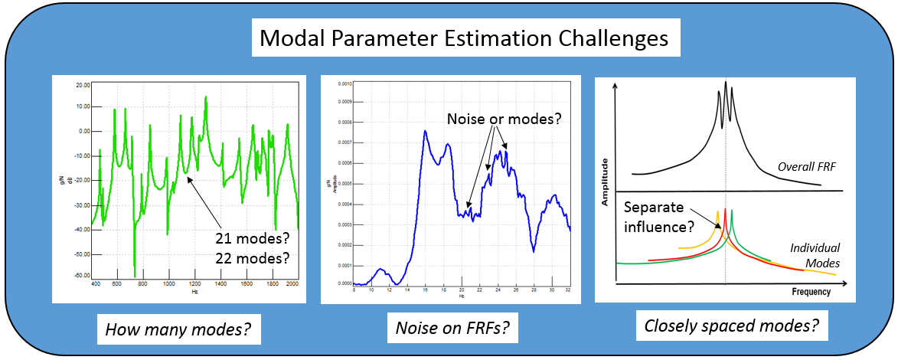
Project Motivation
Existing methods require expert knowledge
Image Taken From: https://community.sw.siemens.com/s/article/getting-started-with-modal-curvefitting
Notes:
Existing methods require lots of user intervention/ expert knowledge/ are computationally expensive
Sometimes even hard for a user to determine e.g. if many closely spaced modes, or if very noisy + existing methods can fail here

Slide 4
Project Structure and Aims
1. Machine Learning
Estimate modal parameter ranges and possible modes
2. Bayesian Inference
Use prior estimates to get uncertainty bounds on parameters
Notes:
ML to replace ‘expert knowledge’ (previously input number of modes, etc)
Bayesian fitting requires initial estimates of parameters
Want uncertainties on modal parameters as opposed to just point estimates (reason in terms of a set of possible explanations for the data, as opposed to just one)
Potential long term aims: all in one modal analysis tool – highlights interesting features in data, tell user if double peak, if modal analysis not possible on given data etc.

Slide 5
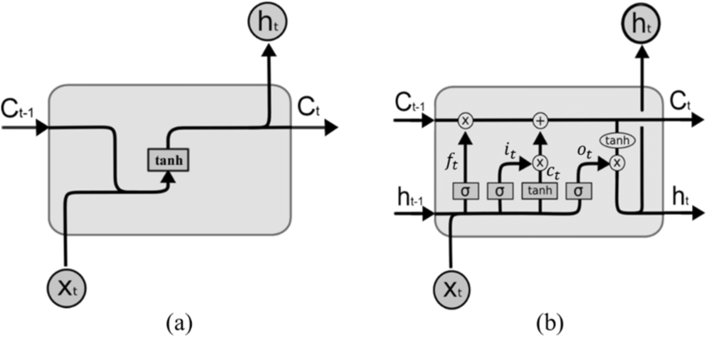
Possible Approaches
Architectures considered: CNNs / RNNs / LSTMs / Transformers
LSTM architecture allows to capture long range dependencies, but is more complex than RNN
RNN Cell
LSTM Cell
Image Reference: Zhou, Sizhe. ‘E-Commerce Sales Forecast Based on Neural Network LSTM’. Proceedings of the 2nd International Conference on Mathematical Statistics and Economic Analysis, MSEA 2023, May 26–28, 2023, Nanjing, China, EAI, 2023. Crossref, doi:10.4108/eai.26-5-2023.2334251.
Notes:
Various architectures considered
Candidate architecture to go with sequence models (designed to deal with sequences of data, which is what we have)
In particular RNNs (Reccurent Neural Networks)
Network made up of many cells, pass information between each other
LSTM is more complex RNN cell design, capture long range dependencies, important as datapoints can be influenced by modes far away
Both implemented, LSTM better so going to be covered here

Slide 6
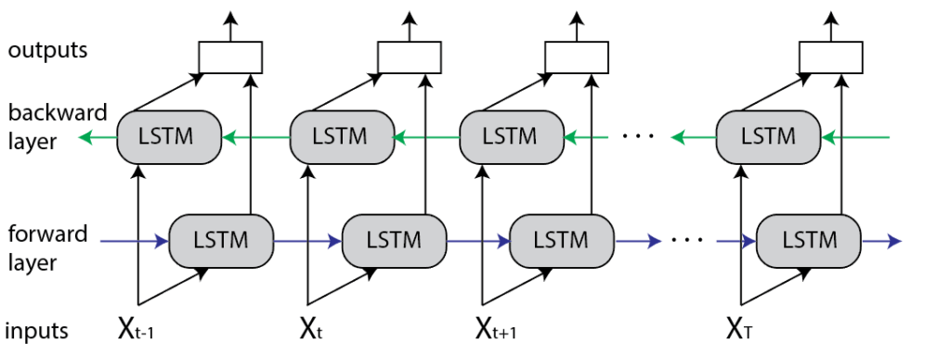
Chosen Architecture (Bi-directional LSTM)
Multi-layered version of the following:
Input sequence can be any length
Image Taken From: https://www.baeldung.com/cs/bidirectional-vs-unidirectional-lstm
Notes:
Input real and imaginary part of transfer function for each frequency
Pass this to LSTM cells, perform calculations within themselves to understand patterns in the data
Forwards and backwards layer as we want model predictions at particular frequency to take into account response at higher and lower frequencies
For each frequency input, output a probability that that point belongs to a mode
In reality, multi-layered to learn more complex dependencies/ patterns in the data

Slide 7
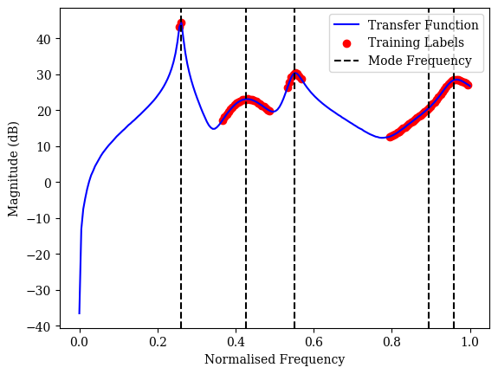
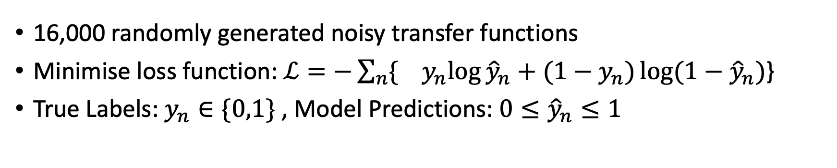

Model Training
16,000 randomly generated noisy transfer functions
Minimise loss function:$ℒ=−\sum_{n}{{\{ y}_{n}\log{{\hat{y}}_{n}+{(1−y}_{n})\log{(1−{\hat{y}}_{n})}}}$}
True Labels: $y_{n}∈\{0,1\}$ , Model Predictions: ${0≤\hat{y}}_{n}≤1$
$$w$$
Notes:
Visualisation of training data example: 5 modes, dashed line indicates natural frequency
Red labels are the ground truth (what we want the model to output as a mode)
Labelled in the 3db bandwidth of each mode
Generate thousands of these using modal summation formula, add noise independently to real and imaginary parts, random num modes, natural freqs, damping ratios and modal amplitudes
Network is trained by minimizing the loss function over all this data
Parameters of LSTM updated iteratively for each pass through the data

Slide 8
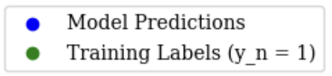
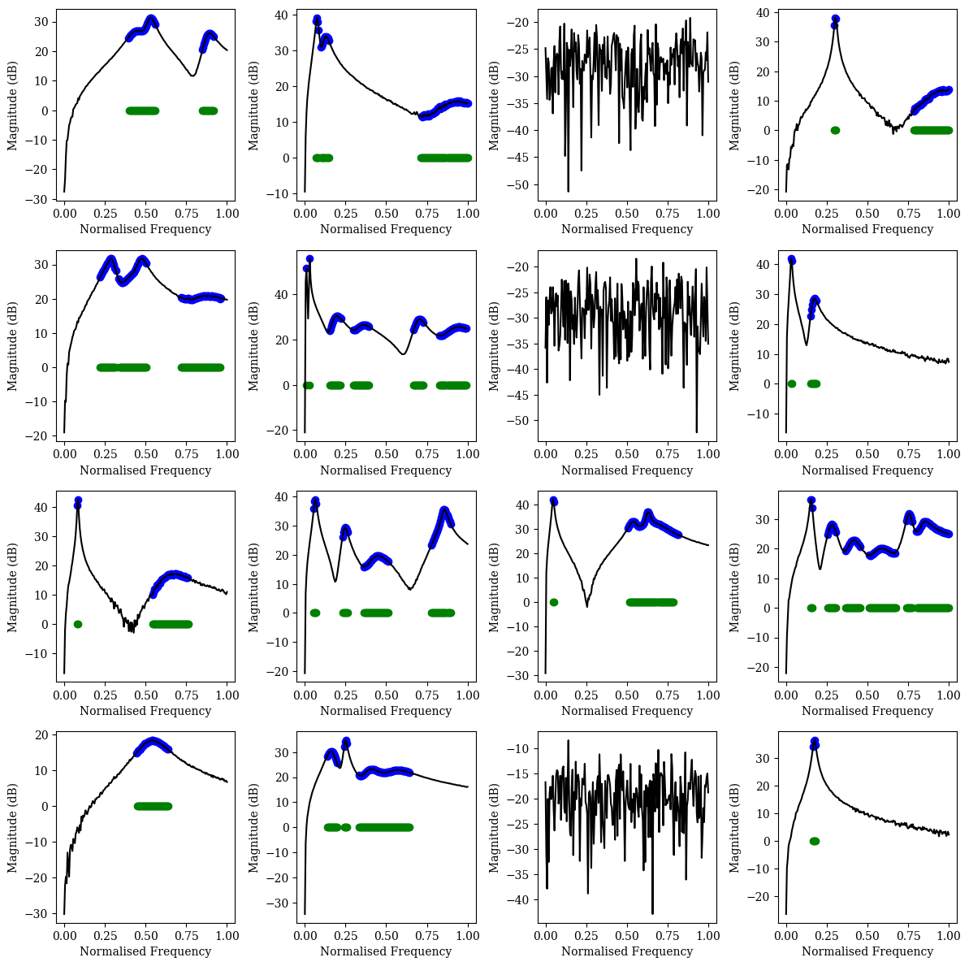
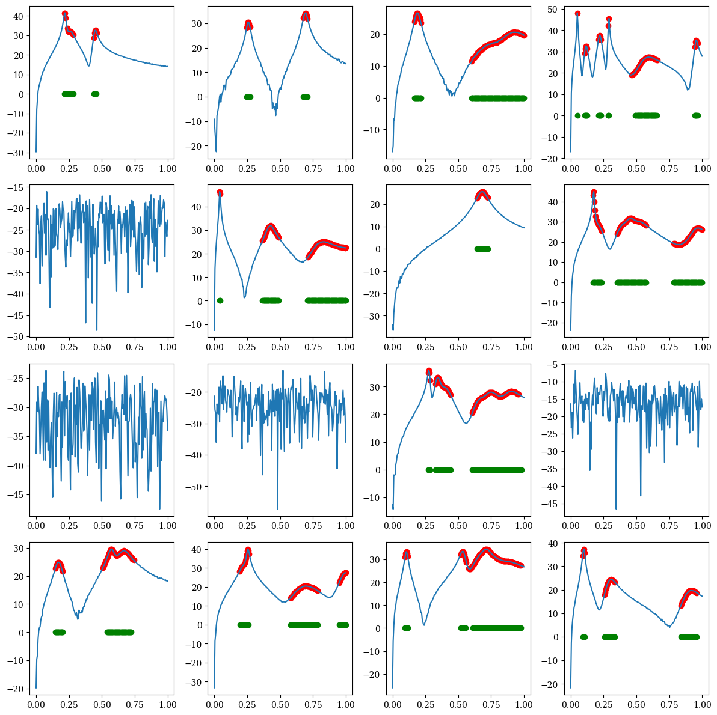
Current Predictions 98.8% Precision 99.0% Recall (on Validation set)
Notes:
Plots taken from validation set
Able to identify peaks well, don’t identify noise as peaks

Slide 9
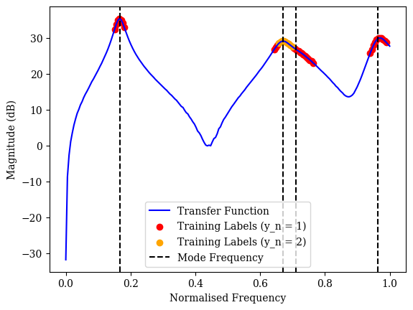
Next Steps
1. Try on real data
2. Multiple Classes
3. Bayesian Inference
Notes:
Bayesian: explain data by considering a variety of possible models

Slide 10
Questions?

Slide 11
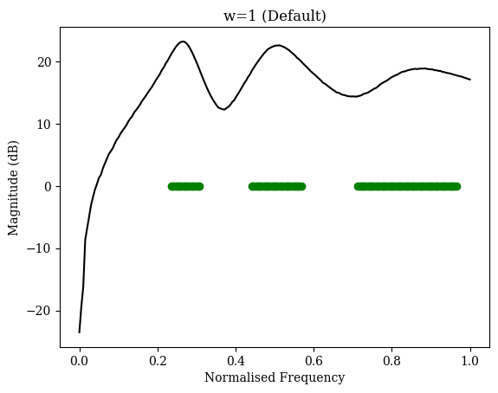
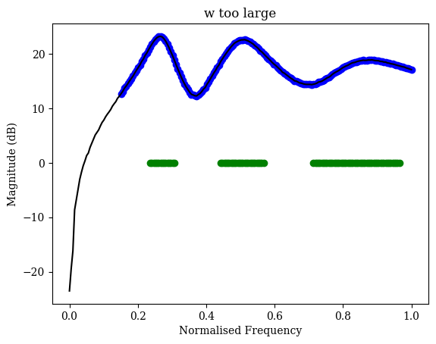

First Results
Model is underpredicting!
Sparse dataset - need to modify loss function
$ℒ=−\sum_{n}{{\{w y}_{n}\log{{\hat{y}}_{n}+{(1−y}_{n})\log{(1−{\hat{y}}_{n})}}}$}
Notes:
Training labels in green
Model underpredicting, makes sense due to sparse dataset – loss function minimized by simply not predicting any modes
Modify loss function
(also increase max number of modes in training data)

Slide 12
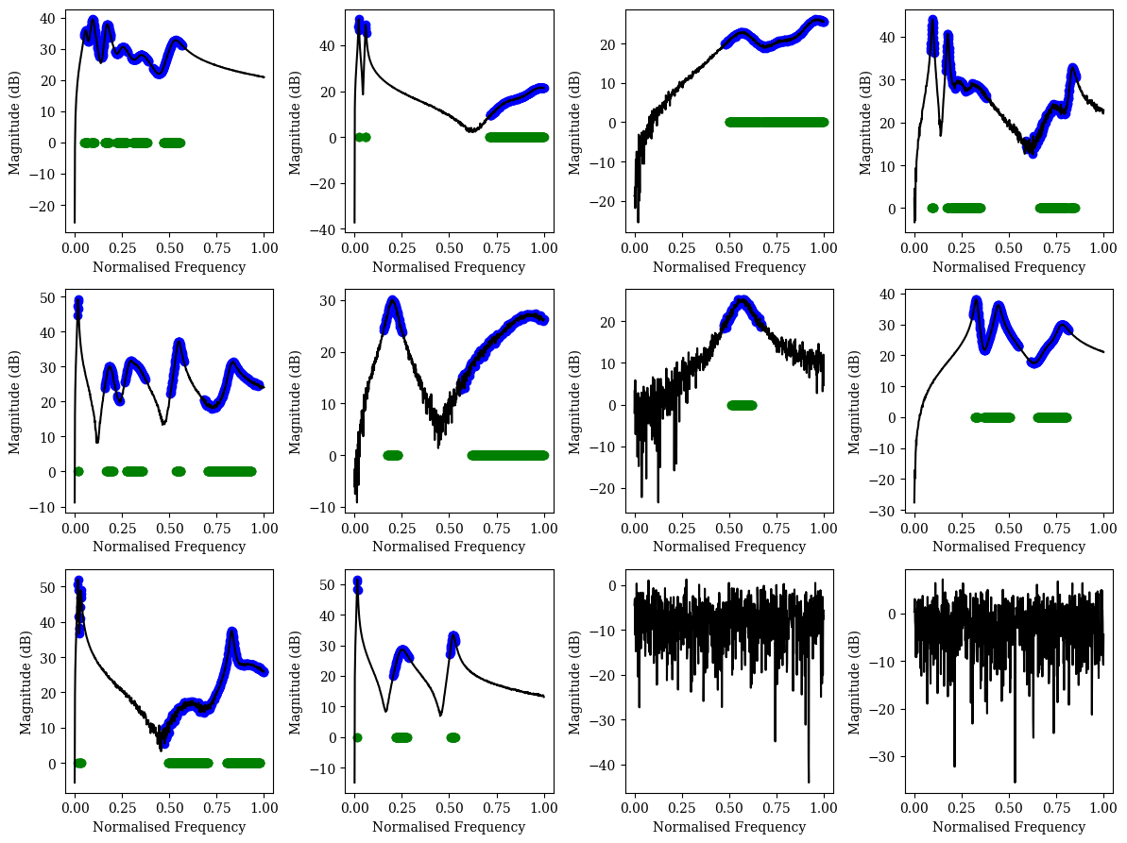
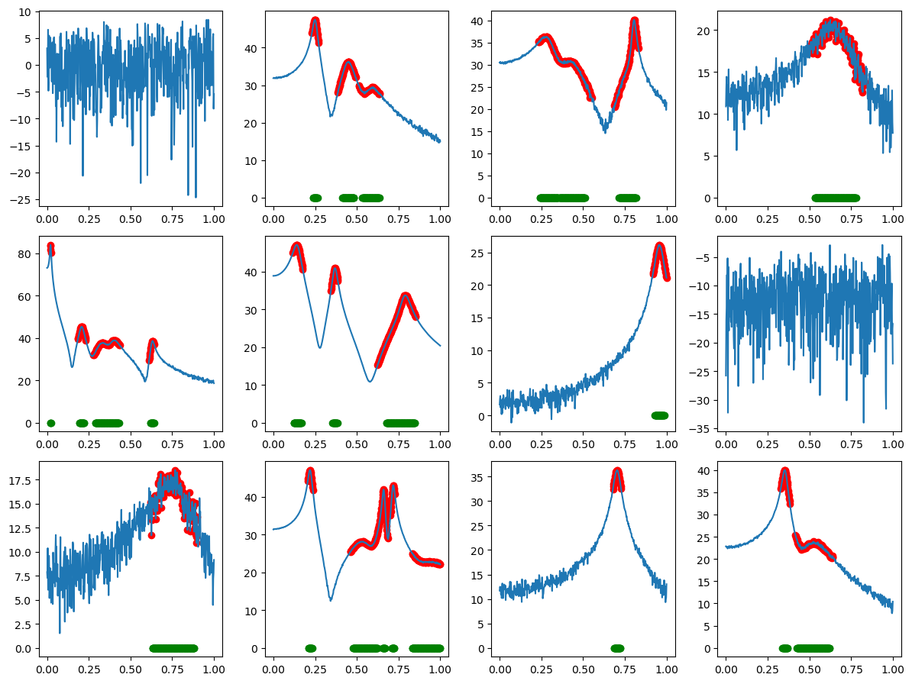
Noisy Data and Longer Sequences

Slide 13

Appendix 1: Evaluation Metrics
$$Precision= \frac{True Positive}{True Positive+False Positive}$$
"Of all the instances that the model predicted as positive, how many are actually positive?”
$$Recall= \frac{True Positive}{True Positive+False Negative}$$
"Of all the actual positive instances, how many did the model correctly identify?"

Slide 14
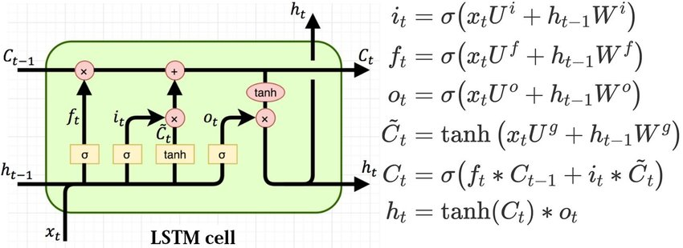

Appendix 2: LSTM Details
Cell state $c_{t}$(long term memory), hidden state $h_{t}$ (short term memory)
Forget gate $f_{t}$ (what percentage of long term memory is remembered)
Input gate $i_{t}$ (how we should update the long term memory)
Output gate $o_{t}$(determines new short term memory)
Image Taken From: https://www.researchgate.net/publication/329362532_Designing_neural_network_based_decoders_for_surface_codes/figures?lo=1
Notes:
https://www.researchgate.net/publication/329362532_Designing_neural_network_based_decoders_for_surface_codes/figures?lo=1

Slide 15
RNN Cell
LSTM Cell
RNN Cell
LSTM Cell

Slide 16
RNN Cell
LSTM Cell

Slide 17
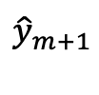









Outputs
$${\hat{y}}_{m−1}$$
$${\hat{y}}_{m}$$
$${\hat{y}}_{m+1}$$
$${\hat{y}}_{M}$$
Backward
layer
LSTM
LSTM
LSTM
$$…$$
LSTM
Forward
layer
LSTM
LSTM
LSTM
$$…$$
LSTM
Inputs
$$X_{m−1}$$
$$X_{m}$$
$$X_{m+1}$$
$$X_{M}$$

